Slide 1
The Subgenres of Hip Hop
By Shawn Garrick

Slide 2
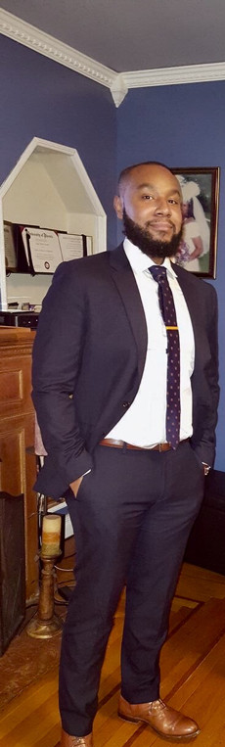
About Me:
Data Scientist
Air Force Veteran
Former Dj
May or may not have tried to rap on youtube a long time ago

Slide 3

Rapper Logic 2020 Interview
"...me, Tyler, the Creator, Cardi B, Polo G, Doja Cat….we should not be in the same category at the Grammys,”
"I really believe that. That doesn’t mean that any one of us is superior or less than the other person, it means we all make different music, we just make different music. But they just put us all together in hip-hop or whatever the case may be.."

Slide 4
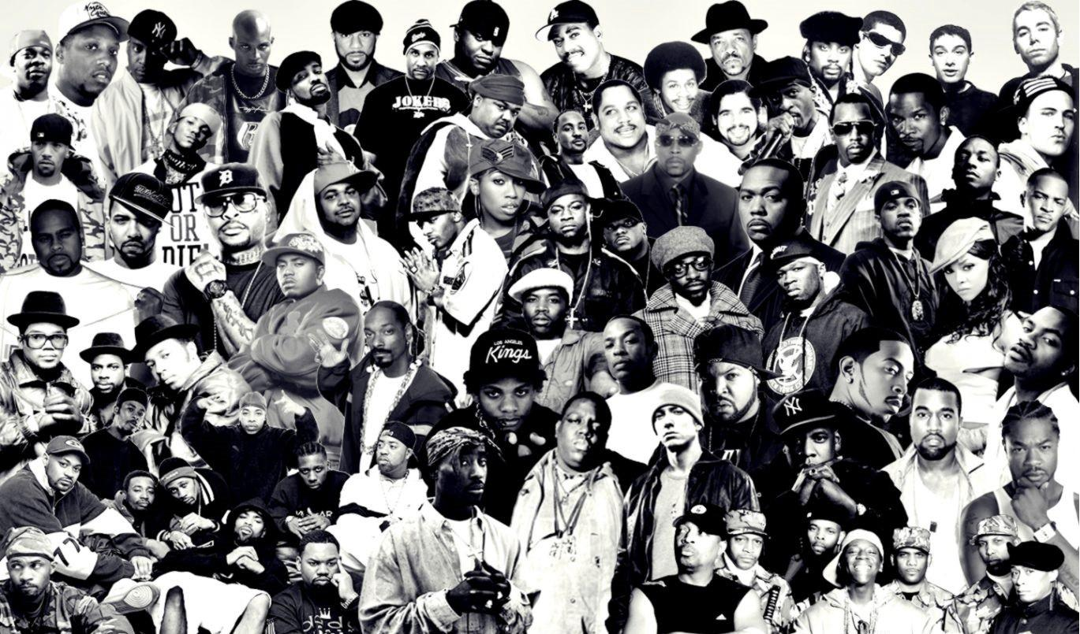
What is Hip Hop music?
Hip hop music, also known as rap music, is a genre of popular music developed in the Bronx borough of New York City in the 1970s. (Encyclopedia Britanica)
In 2018, hip-hop and rap music accounted for 21.7 percent of total music consumption in the United States making it the most consumed genre of music in the US (Statista)

Slide 5



The Data
5000+ song database. The most 50 popular songs on Genius.com from 100+ rap artists.
To get the lyrics, I used lyricsGenius, a Python library by Johnwmillr
billboard.py is a Python API for accessing music charts from Billboard.com
Audio features from spotipy

Slide 6
NLP and Topic Modeling
Td/idf dense matrix ~ 27021 unique terms

Slide 7
Classification Method
Lyrical/Introspective | Club | Romance | Mumble | Old School/Street | New School/Street
0.070560 | 0.016913 | 0.010955 | 0.000000 | 0.000050 | 0.001089
Lyrical/Introspective | Club | Romance | Mumble | Old School/Street | New School/Street
0 | 0.01 | 0.02 | 0.0007 | 0.04 | 0

Slide 8
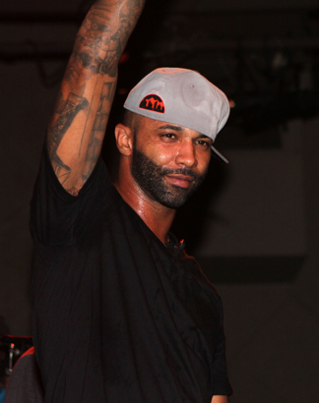
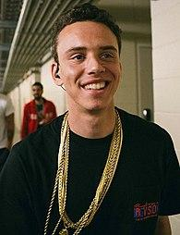
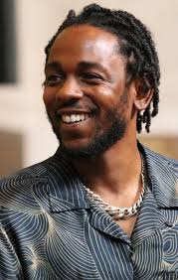
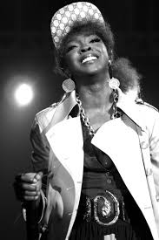
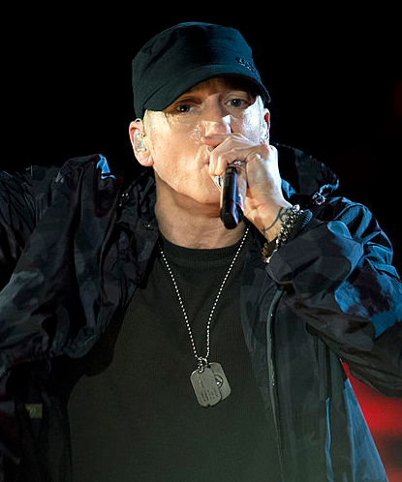
Lyrical/Introspective
Notable Rappers[from top left, clockwise]: Joe Budden (+.04), Logic(+.03), Kendrick Lamar(+.02), Lauryn Hill(+.02), Eminem (+.02)
Words Associated with Topic:
life, feel, away, would, day, never, everything, us, could, god, mind, world, ever die, people, way, said, time, pain
The mean Lyrical/Introspective score of all songs was 0.021
27% of songs were classified as Lyrical/Introspective
Avg # of Unique Words: 274

Slide 9
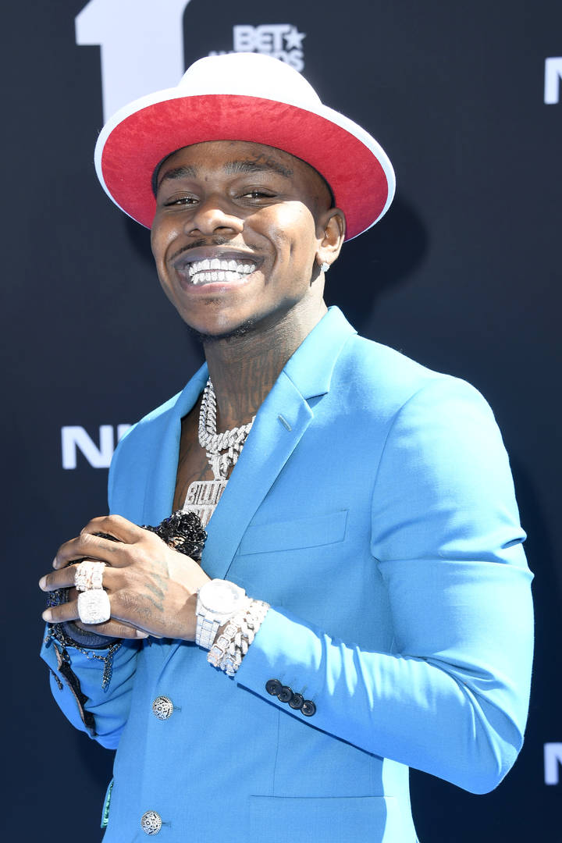
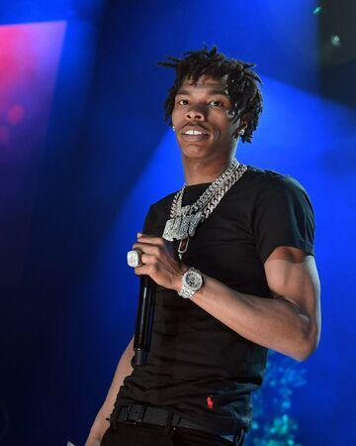
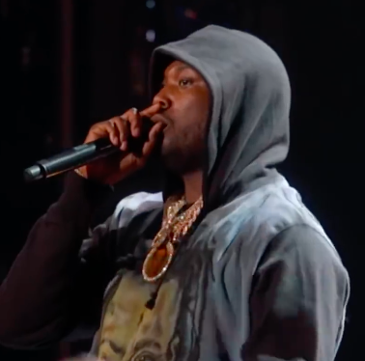
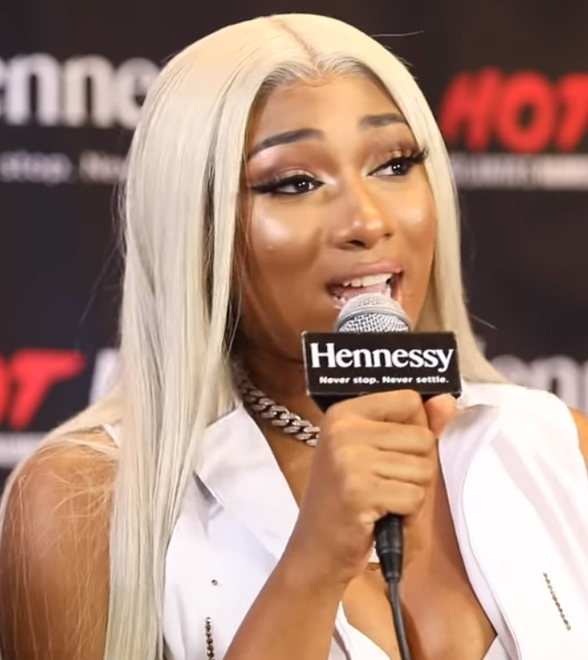
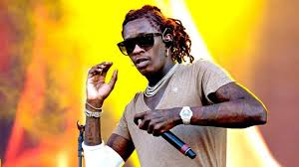
Club/Materialistic
Notable Rappers(from top left, clockwise): DaBaby (+.03), Lil Baby(+.04), Meek Mill(+.03), Megan Thee Stallion(+.02), Young Thug (+.02)
Words Associated with Topic:
money, fuck, hoes, h*, p**sy, gang, lil, sh*t, ass, bad, d*ck, boy, pull, rich, smoke, hundred, big, diamonds, getting, new, talkin
The mean Club/Materialistic score of all songs was 0.021
26% of songs were classified as Club/Materialistic
Avg # of Unique Words: 243

Slide 10

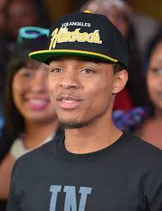
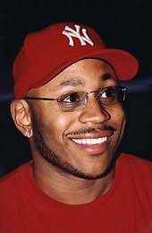

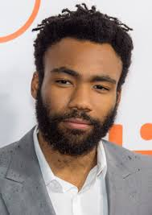
Love & Romance
Notable Rappers[from top left, clockwise]: KYLE (+.02), Bow Wow(+.03), Childish Gambino(+.02), Drake(+.02), LL Cool J(+.02)
Words Associated with Topic:
love baby girl wan need hey shawty want girls good right let tell tonight hold night body long make sex bad take crazy mine
The mean Love/Romance score of all songs was 0.014
12% of songs were classified as Love/Romance
Avg # of Unique Words: 218

Slide 11
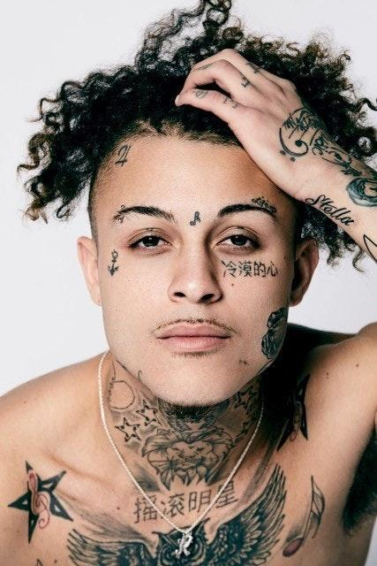
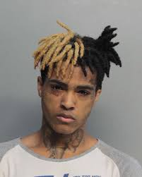
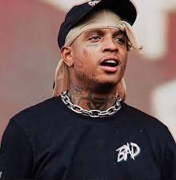
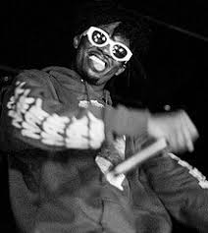
Mumble/New Age
Notable Rappers[from top left, clockwise]: Lil Skies (+.68), XXXtentacion(+.22), Ski Mask the Slump God(+.73), Playboy Carti(+.18)
Words Associated with Topic:
ayy huh ah lil yuh diamonds wait pull yah shawty work safe finna boy want hey f*ck bands gang bust hmm wishinracks
The mean Mumble score of all songs was 0.0005
4% of songs were classified as Mumble
Avg # of Unique Words: 213

Slide 12
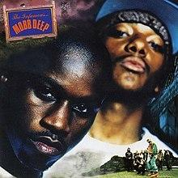
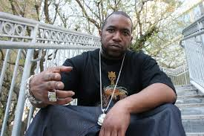
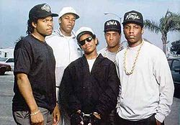
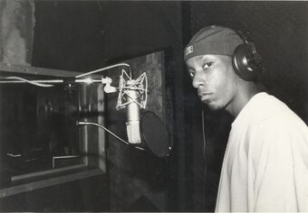
Old School Gangsta Rap
Notable Rappers[from top left, clockwise]: Kool G Rap (+.04), Mobb Deep(+.04), NWA(+.03), Big L(+.04)
Words Associated with Topic:
rap wit black man rock motherfucker ass check gangsta big gun mic bust g run rhymes style one rhyme street crew game
The mean Old School Rap score of all songs was 0.02
26% of songs were classified as Old School Rap
Avg # of Unique Words: 327

Slide 13

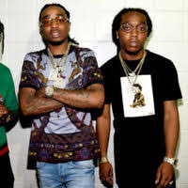

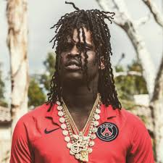
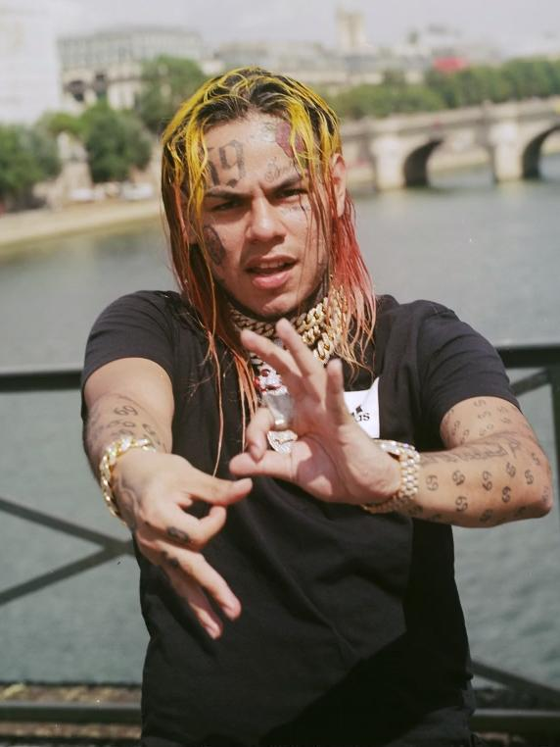
New School Gangsta Rap
Notable Rappers[from top left, clockwise]: 21 Savage, Migos, 6ix9ine, Fivio Foreign, Chief Keef
Words Associated with Topic:
gang gucci bang bust slaughter pump taylor murder lied lil pull wolf yuh shit chain scum stain truly somehow addicts savage name rollin die wet throw drug rep
The mean New School Rap score of all songs was 0.02
3% of songs were classified as New School Rap
Avg # of Unique Words: 236

Slide 14
Audio Features
Danceability, Tempo

Slide 15
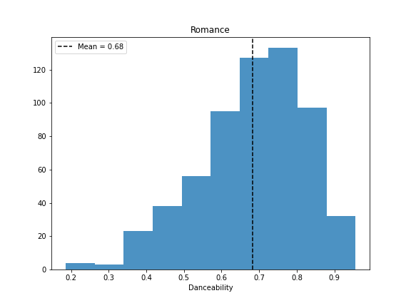
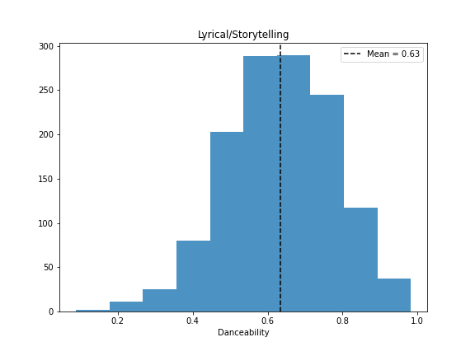
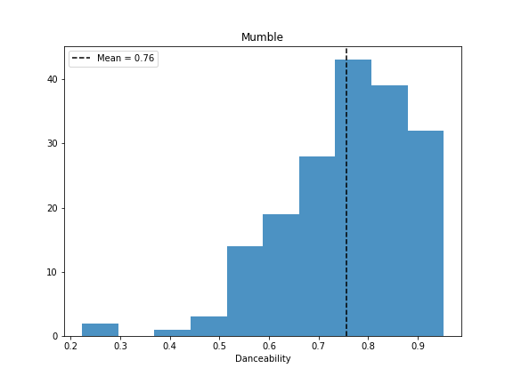
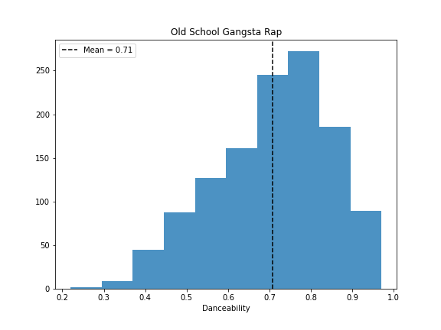
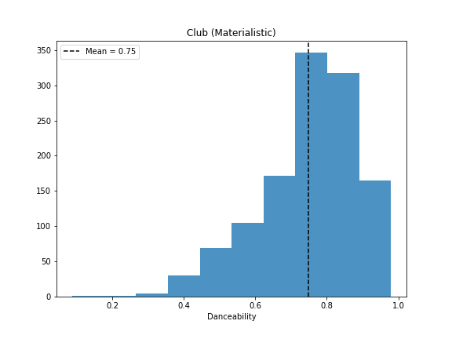
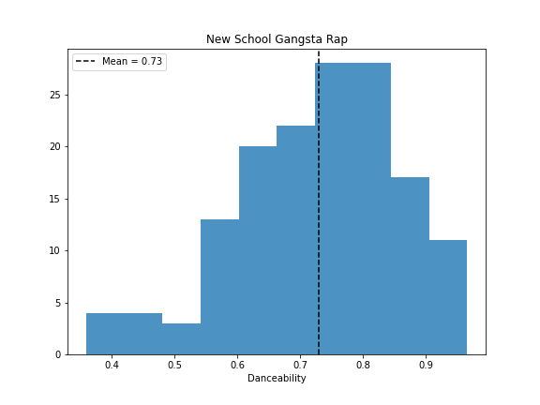

Slide 16
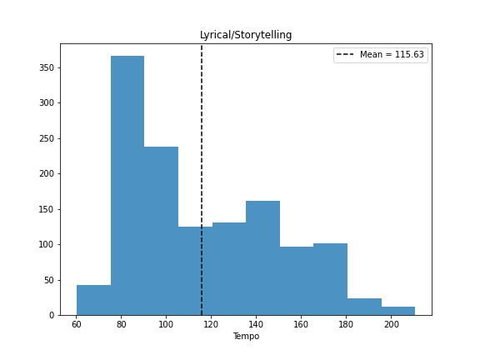
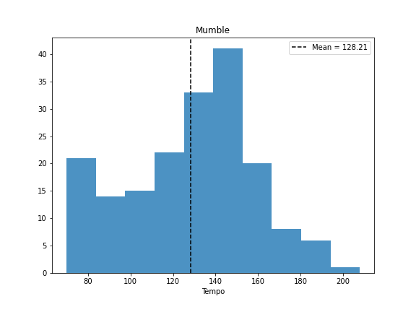
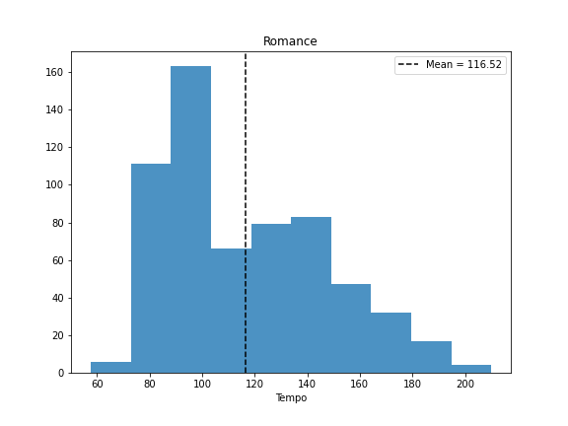
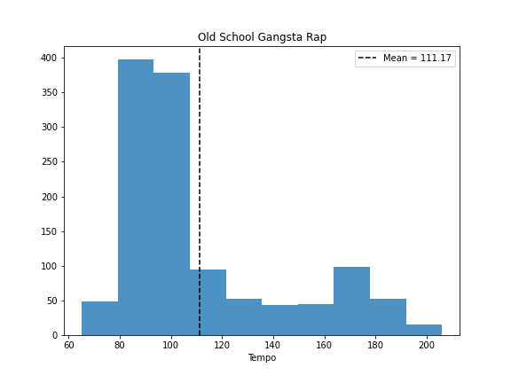
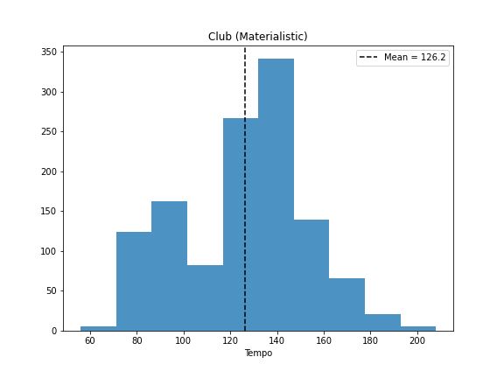
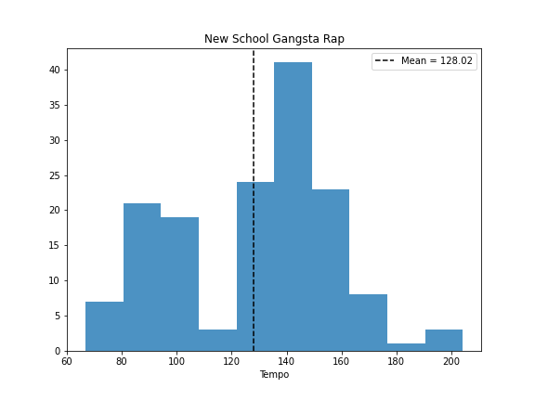

Slide 17
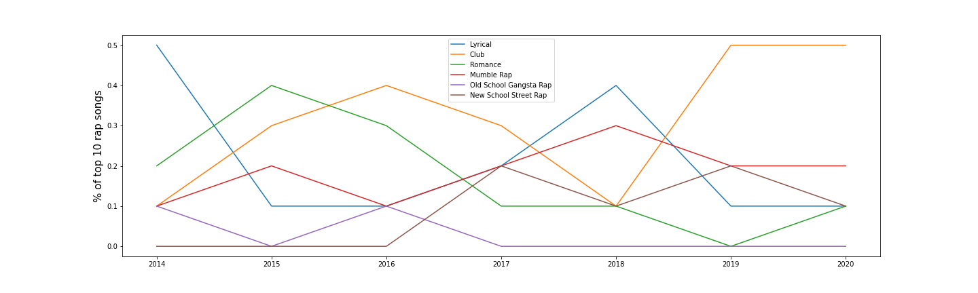
Billboard top 10 Rap Songs from 2014-Present

Slide 18
Improvements
Better Classification method
Use song metadata/audio features for more accuracy
Build model with more genres (bigger database)
Write playlist building/song recommending algorithm

